Slide 1

DevOps - IBM Rational Tools

Slide 2

Agenda
1
IBM DevOps Solutions
2
Collaborative Lifecycle Management
3
CLM Application and Capabilities
4
Rational Doors
5
Rational Quality Manager
6
RSA Design Manager
7
Rational Team Concert
8
JRS Capabilities

Slide 3
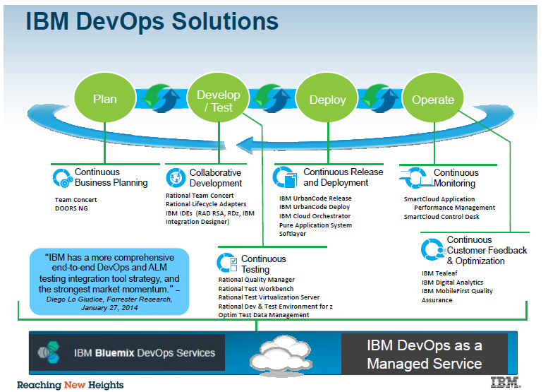

Slide 4


Collaborative Lifecycle Management Deliver greater value through integration
IBM Rational Collaborative Lifecycle Management is a set of seamlessly integrated tools that work together as one and it coordinates people, processes, and information in iterative software and systems delivery.
Rational Collaborative Lifecycle Management
Key Features
Reduce Cost
Reduce Time to Delivery
Increase Value
Improve Quality
Improve Predictability
E2E Traceability
Scale & integrate with existing systems
Developer
Quality Professional
Analyst
Designer
Rational Team Concert
Rational Software Architect
Rational Quality Manager
Rational DOORs
Collaboration, integration and transparency

Slide 5
CLM Applications and Capabilities
Change and Configuration Management (CCM)
CCM provides capabilities for Change Management (work items), Software Configuration Management, Planning and automation build.
Requirement Management (RM)
RM provides capabilities for capturing, managing and tracing requirements through out the project lifecycle.
Quality Management (QM)
QM provides capabilities for test management that includes test planning, creation and execution.
Design Management (DM)
DM provides capabilities for in-context collaboration, traceability and impact analysis, agile sketching and domain modeling.

Slide 6
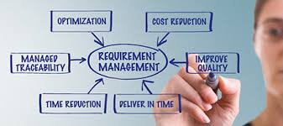
Rational DOORS
Workflow
Assessing the problem
Creating, reviewing and managing requirements
Enabling configuration management (optional)
Project Transparency
Customizable web based project specific and personal dashboards
Real time metrics and reports in terms of coverage
Achievement in meeting project schedules by non ambiguous requirements formulation
Management
Artifacts
Business Goals
Tracing and Impact analysis
Status and milestone tracking
Customizing requirement artifacts
Clear Case ,RTM,RQM,RPM integrations
Reviewing requirements artifacts
Create custom artifact types , attributes, data types, link types, and project templates Query results view and share queries with team or member
Create project baselines
Generate reports
Create traceability between requirements and models and design resources.
Create and view suspect traceability links to monitor the impact of change in linked artifacts.
In CLM Rational doors extends traceability between requirements, design and test teams thereby facilitating collaboration
To keep all the stakeholders on the same page by communicating requirements effectively
To avoid project specific costs later in the development cycle by eliciting requirements completely and consistently
Analyze requirements to norms and standards to facilitate better customer satisfaction.
Study the impact of change in requirements early so that project risks are mitigated.
Jazz Team Server
Single structure for project related artifacts
World-class team on-boarding / off boarding including team membership, sub-teams and project inheritance
Role-based operational control for flexible definition of process and capabilities
Team advisor for defining / refining “rules” and enabling continuous improvement
Process enactment and enforcement
In-context collaboration shows team members and status of their work

Slide 7
Rational Quality Manager
EXECUTION PLANNING
Identify and define requirements
Develop test plans
Develop test cases
Monitor test construction
Plan test execution and recording
Track test efforts
Project Transparency
Collaborate—share project information and status updates seamlessly Automate—reduce labor-intensive activities to accelerate project schedules.
Govern—understand and report on project metrics to enable accurate, reliable and timely release decisions.
Management
Task Items
Business Goals
Seamlessly share information
Test authoring activities
Project life cycle management
Manage the manual testing effort
Process awareness
Define test process ,strategy and responsibilities
Dashboard provides an at-a-glance view of test artifacts, work item queries, event feeds, reports, and other items that are critical to understanding your progress
Migration capabilities from excel, word and xml files give a centralized place for storing test process information
Create, edit, and version test plans and test cases and approve the same
Assign work items
Run and review reports to track project status
Create test execution records
Run test execution records by manual and automated scripts
Create, reuse and review test cases and manual test scripts
Request, fulfill and manage test lab resources
Complete CLM and end to end traceability of test to requirements for complete validation
Shipping high quality defect free product and meeting customer needs.
To meet stringent deadlines and facilitate collaboration between development and testing teams
Smooth and consistent project workflow ensuring customer satisfaction
Integration capabilities with other test execution products and other products, requirements management products, change management allow business to achieve a common goal of fast delivery.
Jazz Team Server
Single structure for project related artifacts
World-class team on-boarding / off boarding including team membership, sub-teams and project inheritance
Role-based operational control for flexible definition of process and capabilities
Team advisor for defining / refining “rules” and enabling continuous improvement
Process enactment and enforcement
In-context collaboration shows team members and status of their work

Slide 8
Rational Software Architect Design Manager
EXECUTION PLANNING
Allows distribution of effort by parallel development
Making testing easier by isolating errors
Promotes reuse
Localizes changes for easier maintenance
Makes the solution easier to comprehend.
Project Transparency
Collaborate—share project information and status updates seamlessly Automate—reduce labor-intensive activities to accelerate project schedules.
Govern—understand and report on project metrics to enable accurate, reliable and timely release decisions.
Task Items
Business Goals
Management
A central design hub stores all designs and makes them searchable and accessible to global extended teams.
An intuitive web client allows access to designs from virtually anywhere and enhances stakeholder collaboration.
Customizable tools and dashboards improve productivity with automated workflows and real-time status of the latest design activities.
Automated reports and documents can be generated from all relevant data sources using the Rational Publishing Engine.
A flexible, extensible architecture allows you to assemble your own software delivery platform, relying on your preferred vendors and solutions.
Use Design Management with Rhapsody and Simulink to allow models to be consumable by a much wider audience..
Design in context to meet goals and objectives
Work seamlessly with analysts, developers, and testers. Make designs first class artifacts in your lifecycle projects.
Collaborate and manage change
Optimize and streamline workflows and to automate tasks. This could result in improved customer/employee satisfaction as well as reduced costs
Maximize ROI
To implement traceability between Requirements and code and further to test
Manage design reviews in a team environment
Use dashboards for real-time team collaboration
Create reports to communicate model information
Identify the key capabilities of the Design Management offering
Jazz Team Server
Single structure for project related artifacts
World-class team on-boarding / off boarding including team membership, sub-teams and project inheritance
Role-based operational control for flexible definition of process and capabilities
Team advisor for defining / refining “rules” and enabling continuous improvement
Process enactment and enforcement
In-context collaboration shows team members and status of their work

Slide 9
Rational Team Concert
Iteration Planning
Integrated iteration planning and execution
Task estimation linked to key milestones
Out of the box agile process templates
Project Transparency
Customizable web based dashboards
Real time metrics and reports
Project milestone tracking and status
SCM
Work Items
Build
Integrated stream management with flow relationships
Component level baselines
Server-based sandboxes
Identifies component in streams and available baselines
ClearCase connector
Defects, enhancements and conversations
Query results view and share queries with team or member
Support for approvals and discussions
ClearQuest connector
Query editor interface
Work item and change set traceability
Local or remote build servers
Supports ant and command line tools
Integration with build forge
Build definitions for team and private builds
Jazz Team Server
Single structure for project related artifacts
World-class team on-boarding / offboarding including team membership, sub-teams and project inheritance
Role-based operational control for flexible definition of process and capabilities
Team advisor for defining / refining “rules” and enabling continuous improvement
Process enactment and enforcement
In-context collaboration shows team members and status of their work
9

Slide 10
JRS Capabilities
Users of all three CLM products (IBM Rational Team Concert, IBM Rational Quality Manager, and IBM Rational Requirements Composer) can access JRS.
CLM reports implemented in RRDI include the following examples:
Test coverage of requirements
Development item coverage of requirements
Requirements affected by defects
Requirements Test Execution results
Requirements Lifecycle Traceability report

Slide 11

Thank you
Tech Mahindra.

